Slide 1
Healthcare Analytics
CU BOULDER CSCI 5253 DATA CENTER SCALE COMPUTING PROJECT
Mahin Kadabi, Naveenkumar, Vidit Sharma

Slide 2
Accomplishment
The project was done on health care stroke dataset by integrating and utilizing different components in a Big Data Project.
This project is of high importance since it can be implemented in Healthcare data analytics, hospitals and clinics are looking for a new data mining techniques.
Utilizing PySpark, which can be used to analyze a huge amount of complex data in clinics or hospitals.

Slide 3
Dataset Selected
The dataset taken for the project is called Healthcare stroke data and it was downloaded from kaggle.
The dataset has 5000 rows and many columns including id, gender, age, hypertension, average blood sugar levels, etc. There are 12 columns in all.

Slide 4
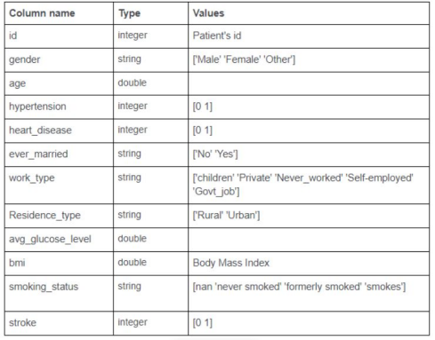
Types of Data available

Slide 5
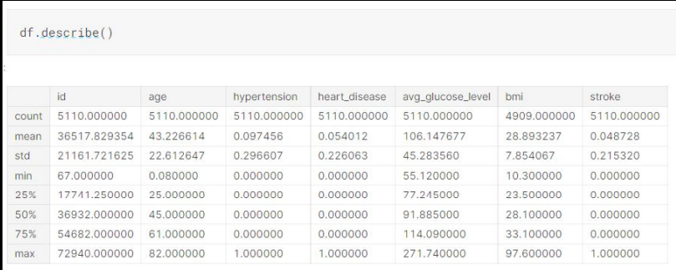
DATASET AT A GLANCE

Slide 6
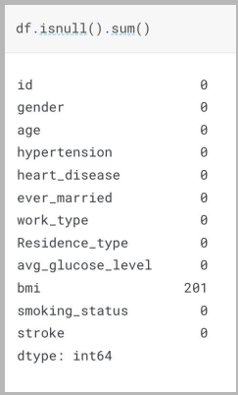
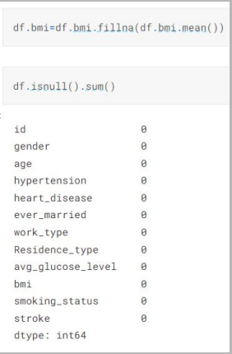
DATA CLEANING AND PREPROCESSING

Slide 7
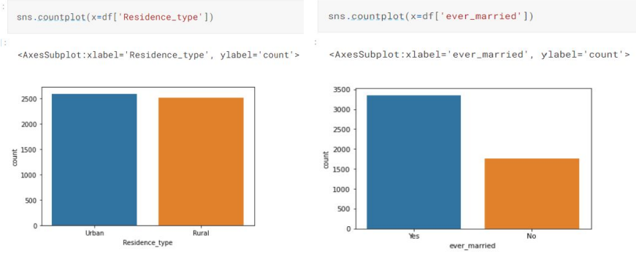
EDA

Slide 8
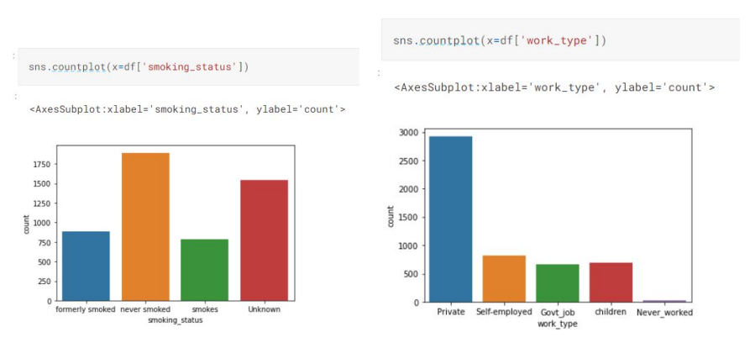
EDA(cont)

Slide 9
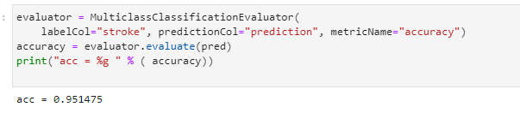
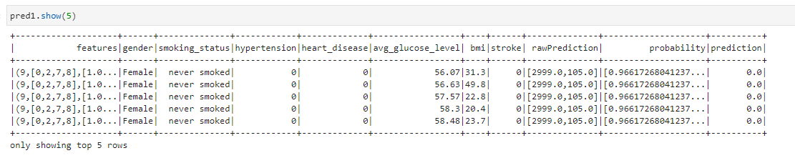
Accuracy of the Model
Prediction Values

Slide 10
Methods
Internal/External Source - The data available is in the form of a CSV file.
● Data Preprocessing - The data is cleaned and preprocessing in this step.
● MySQL- The RDBMS is used to store,retrieve and manage data.
● Data Processing and Machine Learning - Dataset is extracted from the bucket and utilized on PySpark to build a machine learning model.
The output(predicted value) of the machine learning model is then collected as a CSV file in the buckets.
Data Visualization - Data is then transferred from the SQL database to Tableau to perform the data visualization and story.

Slide 11



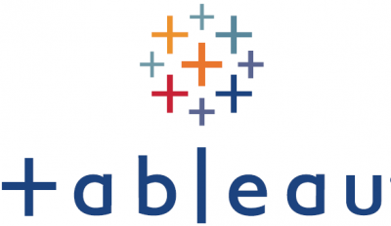

Architecture
DATA SOURCE
DATA PREPROCESSING
DATA STORAGE
CLOUD SQL
DATA VISUALIZATION
CSV DATA
DATA PROCESSING

Slide 12
Project Impact
We were able to integrate Hadoop, Hive, PySpark, CloudSQL and Tableau in our project.
Implementing a cloud like environment for Big Data with data visualizations like Tableau makes it easier to convey a story to the stakeholders.
The major impact of this project is that it can be used to create data pipelines for hospitals which are interested in knowing the distribution of different types of patients and the diseases.

Slide 13
Difficulty faced in Project
One of the main difficulties was to import the dataset into MySQL it took some time.
We had to create a table so that a table name existed for the dataset for us to import into the MySQL database.
Connecting from the Tableau server to the SQL database to perform the visualizations.
Learning how to integrate the different components(Hadoop,PySpark,Cloud SQL, Tableau) using Google Cloud(GCP) required in a big data project.

Slide 14
Interesting part of Project
End to End implementation of ML pipeline on GCP.
Learning how to use cloud SQL on GCP
How to connect my SQL server and how to create to the database on GCP
We learnt how to connect MySQL database to Tableau by using public IP address and the connection name.
With the help of Tableau we are able to display the data Visualization with a meaningful insight.

Slide 15
What is the most valuable thing you learned from conducting the project?
We learnt how to work as a team and organize the different tasks required in our project.
We learnt how to use GCP, Hadoop, MySQL, PySpark, MLpipeline and Tableau for our project.
We learnt the basic components required for a big data project.

Slide 16
Who you are? And what is your role in the project?
Mahin Kadabi → Created Dataproc cluster and buckets on GCP. Worked on data preprocessing, cleaning and few of the data visualizations.Worked on integrating HDFS with Spark and SQL.
Vidit Sharma→ Worked on creating the MySQL cloud instance. Worked on creating the ML Pipeline on PySpark. Worked on connecting the Cloud SQL to Tableau and creating a story on Tableau.
Naveenkumar→ Responsible for few of the EDA’s and preparation of PPT and report.

Slide 17
THANK YOU

